Slide 1
KESA Monthly Update
January 9, 2024
Notes:
Jay
What is your favorite holiday-themed movie to watch this time of year?

Slide 2
Our Vision for Kansas ...
Kansas leads the world in the success of each student
Notes:
Our business cards will stand out as innovative and memorable with a vertical or portrait orientation. Bonus it has a back side!
a portrait or vertical design. It’s also two-sided!
Another fundamental change you may notice (if not you will after I tell you) is that the main address for our agency has been simplified to the main desk in Suite 102. As all our mail is sorted in the print shop having everything labeled by a different team name and suite only made sense to us as we're used to it. It is less confusing and complex for those we serve.

Slide 3
KESA Purpose
As a tool to support Kansas in leading the world in the success of each student, the Kansas Education Systems Accreditation model does the following:
Ensures that each K-12 system has fundamental practices in place at a high level in each classroom
Evaluates each system’s lead indicator data and State Board outcomes
Ensures that each K-12 system is in compliance with all identified compliance areas

Slide 4
Topics for this session
State BOE Action on KESA 2.0
KESA 2.0 Build
Spring 2024 KESA Check-ins
Notes:
Jay

Slide 5
State BOE Action on KESA 2.0
Notes:
Jay

Slide 6
What we asked of the State Board
Approval of KESA 2.0 (beginning in 24-25) including:
The Four Fundamentals as a basis for being accredited in Kansas.
The Annual Accreditation System.

Slide 7
KESA 2.0 State Board Action
…that the Kansas State Board of Education approve the development of the KESA 2.0 model, as presented, that is set to begin in the 2024-2025 school year.
The KESA 2.0 model shall ensure that districts will be accredited based on the four fundamentals, the five board outcomes, student outcomes, and compliance. The model shall also account for current accreditation regulations.
The Board expects an updated, actionable model to be presented for approval by the Board once it is developed. An actionable model would be one that clearly lays out expectations for various levels of accreditation, timelines involved, and responsibilities of KSDE, districts, and the ARC so that all aspects are in place prior to implementation.

Slide 8
KESA 2.0 Build
Notes:
Myron

Slide 9
Priority Projects
Develop the School Improvement Model Structures and Lead Indicators.
Design the templates needed for peer collaboration, gap analysis, and action plans.
Recruit and train facilitators for the peer collaboration, gap analysis, and action planning conversation.
Design the protocol for the deep dive into student performance data.

Slide 10
Priority Projects
Integrate Kindergarten Readiness into the school improvement model and conversation.
Integrate Social and Emotional Learning measured locally into the school improvement model and conversation.
Integrate Individual Plans of Study into the school improvement model and conversation.
Begin intentional collaboration with Service Center and Technical Assistance Systems Network partners.

Slide 11
Supporting Projects
KansasStar, Needs Assessment Alignment
Curricular Materials Audit
Standards Alignment Toolkits
Balanced Assessment & Data Literacy
Professional Development and Mentoring Plan Alignment
Higher Education Collaboration and Alignment
STAR Recognition Alignment
The Kansas Vignettes
Civic Engagement Alignment

Slide 12
KESA Check-Ins
Notes:
Myron

Slide 13
Spring 2024 KESA Check-ins
1-on-1 between a system’s KESA team and a member of the Accreditation & Design team
On-site at the school district
Agenda
Slides
Each system should receive a reminder of the KESA Check-in approximately one week prior to the meeting. Please confirm the location of the meeting by responding to the meeting reminder.

Slide 14
Q & A
What questions do you have?
Notes:
Jay

Slide 15
Resources
Accreditation Resources (updated)
KESA Regional/Cohort Model of Support
Are you signed up for the KESA listserv? If not, email us at accreditation@ksde.org

Slide 16
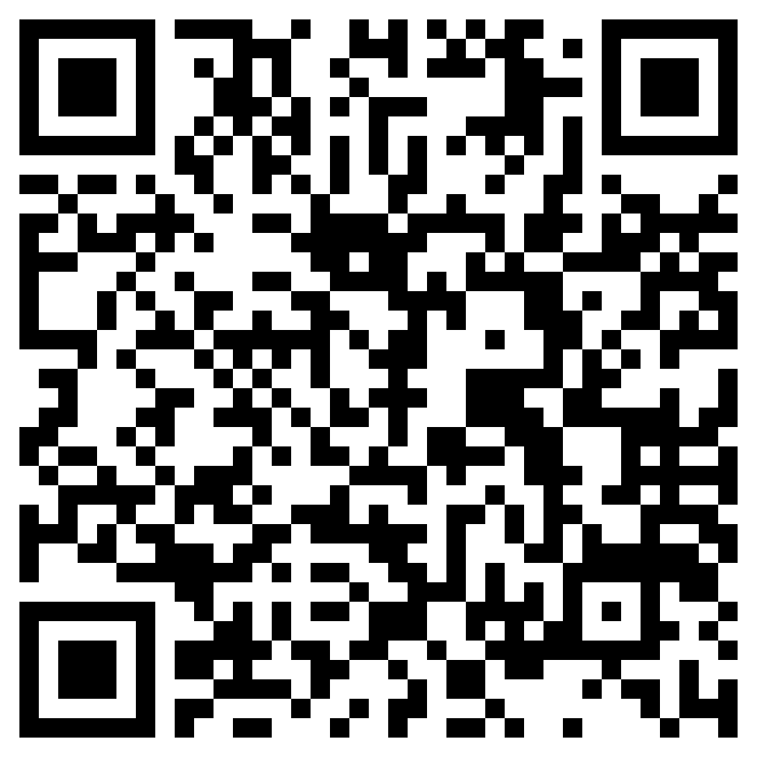
https://forms.gle/ uNUn4iHVoU1d162Y6
Feedback Form
Notes:
Jay

Slide 17
Accreditation & Design
accreditation@ksde.org
Amber Miller, Regional Executive amiller@ksde.org
Myron Melton, Assistant Director
mmelton@ksde.org
Jay Scott, Director jscott@ksde.org
Rue Huereca-Retana, Adm. Specialist rhuereca-retana@ksde.org

